Slide 1
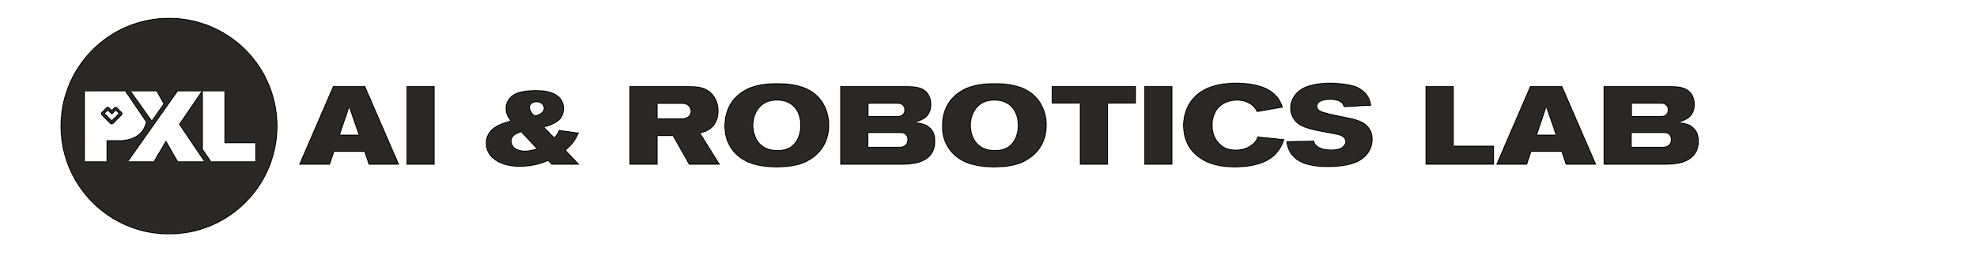
Neural Networks
Transfer Learning – Active Learning

Slide 2
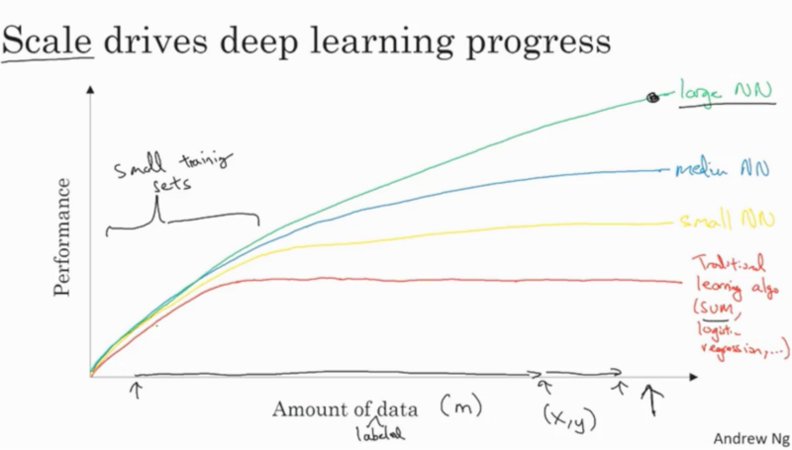
Deep Learning = Data Hungry
2 ways to get great results with reasonable amount of data:
Transfer Learning
Active Learning

Slide 3
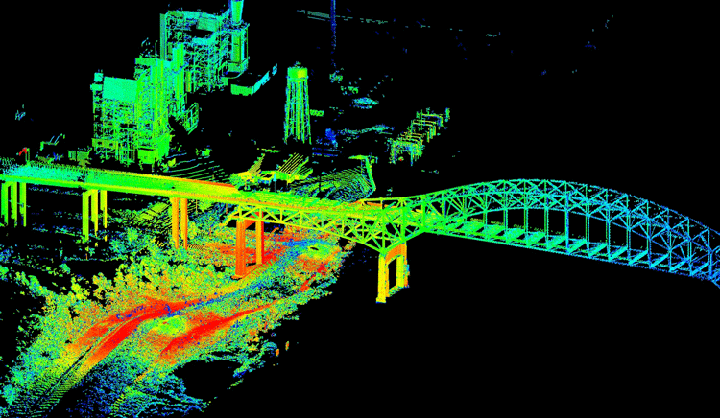
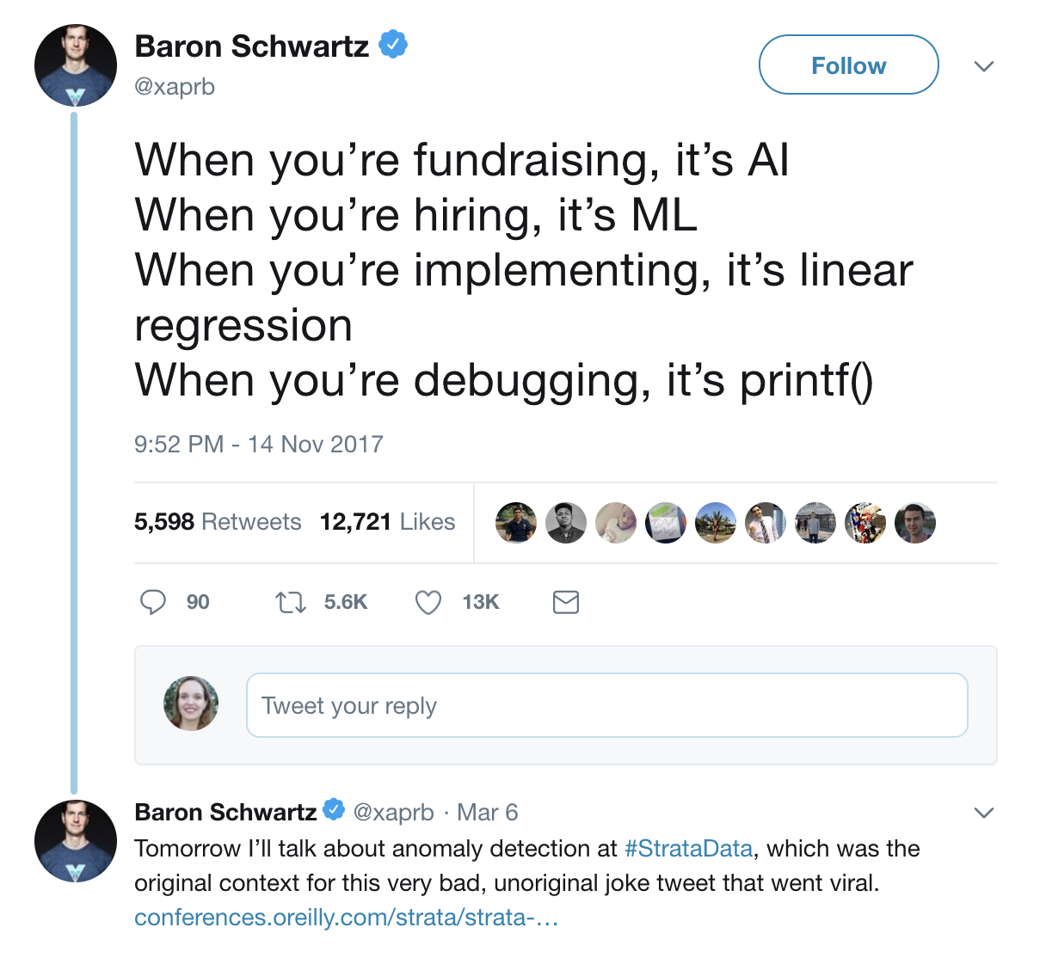
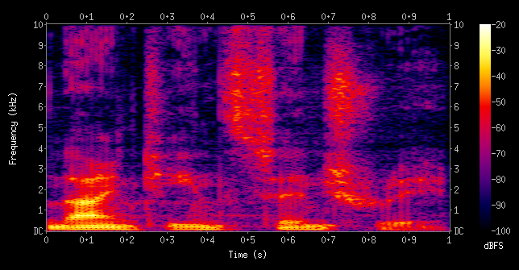
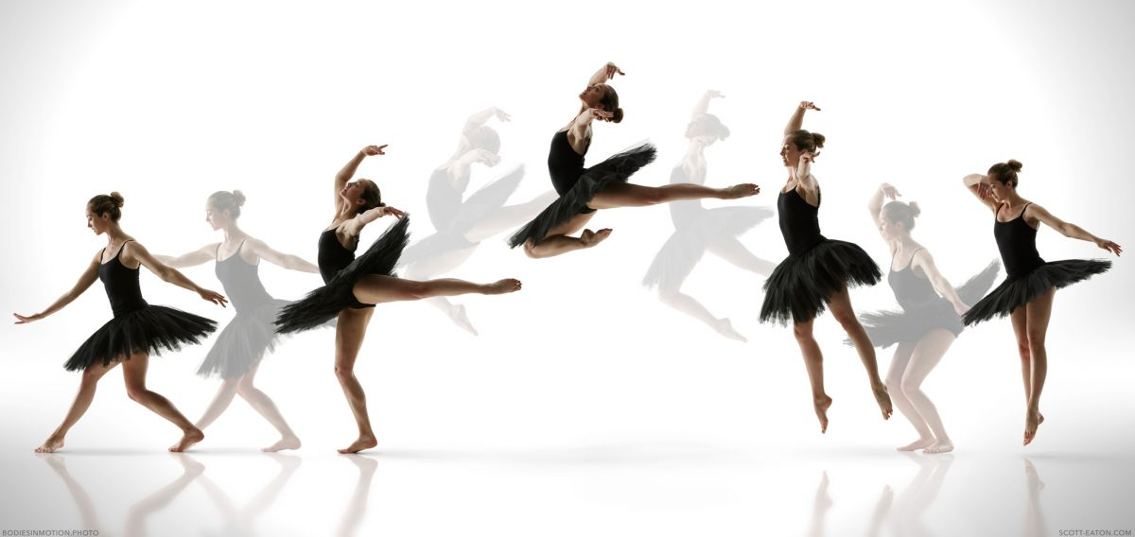
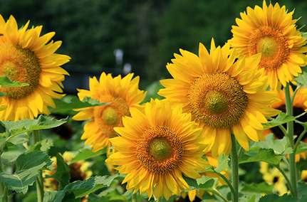
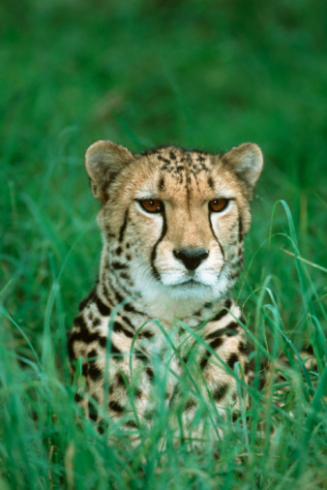
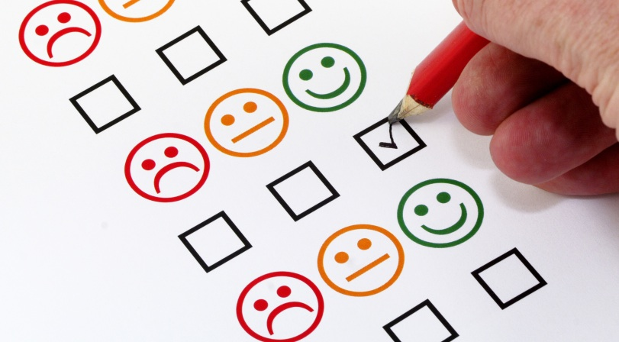

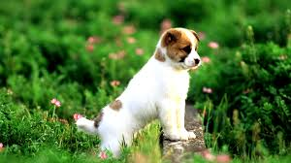
New Data Formats
SENSOR
TEXT
AUDIO
SURVEYS
VIDEO
IMAGE

Slide 4
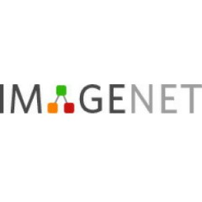
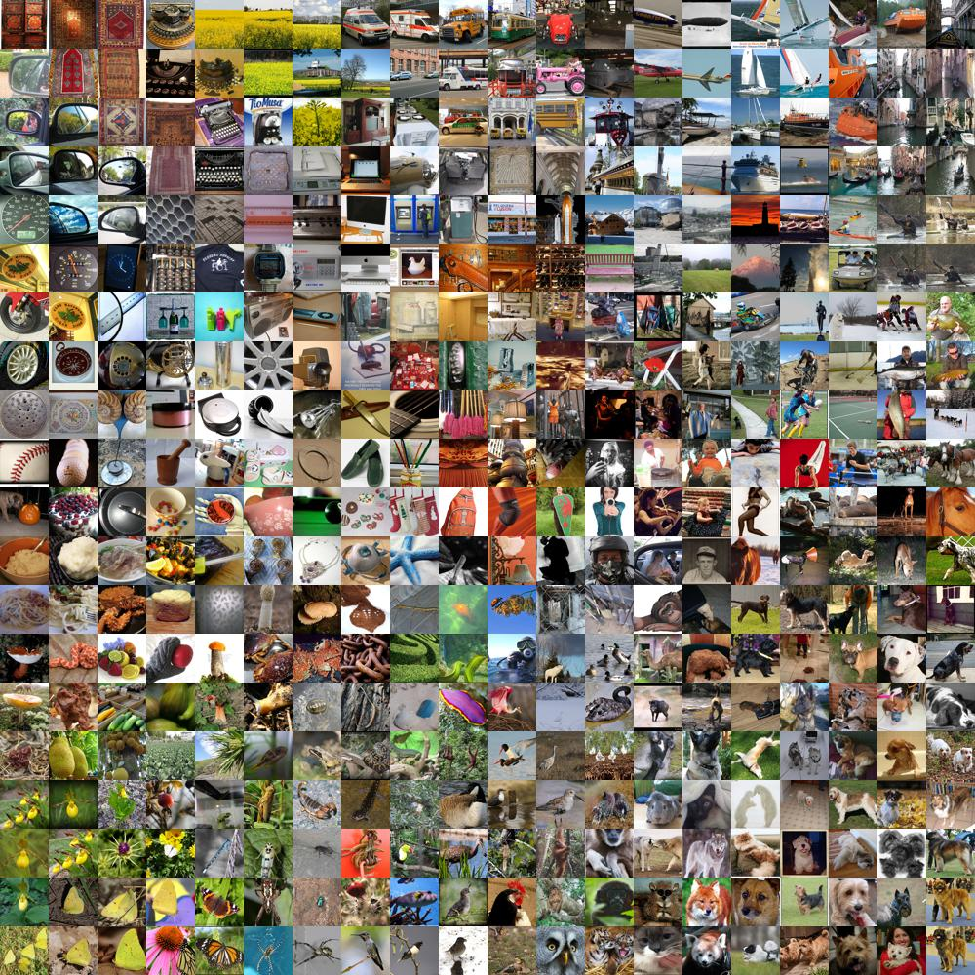
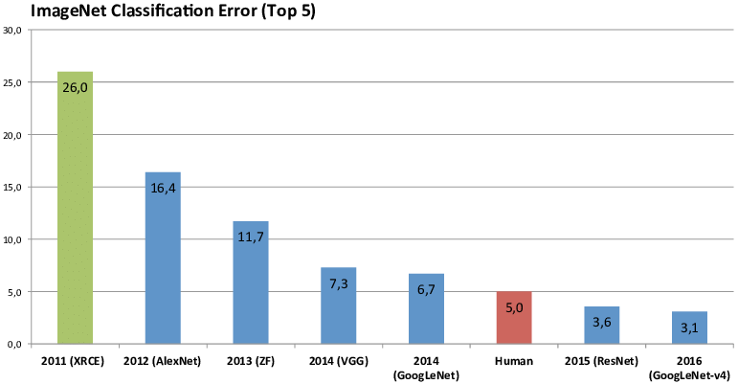
Rise of Computer Vision - ImageNet
1960
2011
2012
2013
2014
2015
2016
Computer vision beginning
14,000,000 labeled images
20,000 categories
ImageNet Classification Error (Top 5)
Notes:
Grote dataset van labeled data, een benchmark, geeft enorme boost aan de ontwikkeling van nieuwe deep learning technieken.

Slide 5
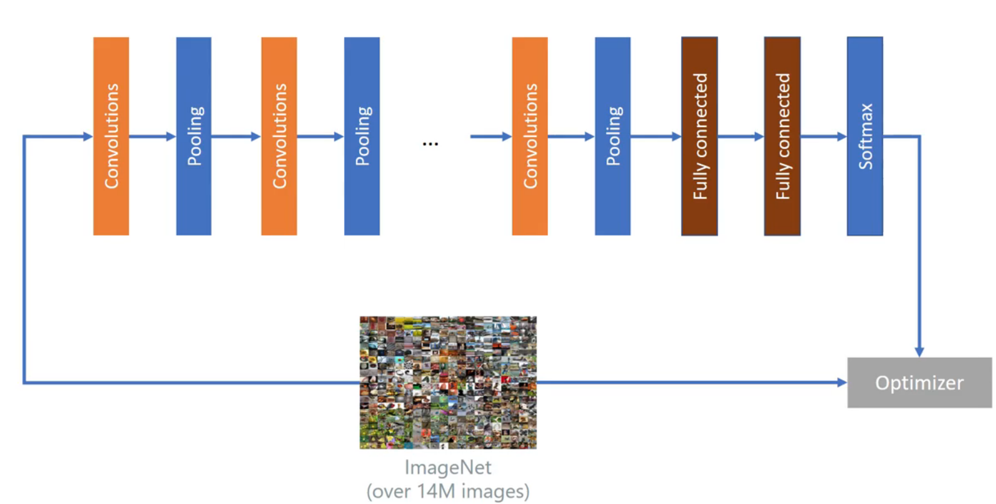
Using Deep Learning (CNN) on Imagenet

Slide 6
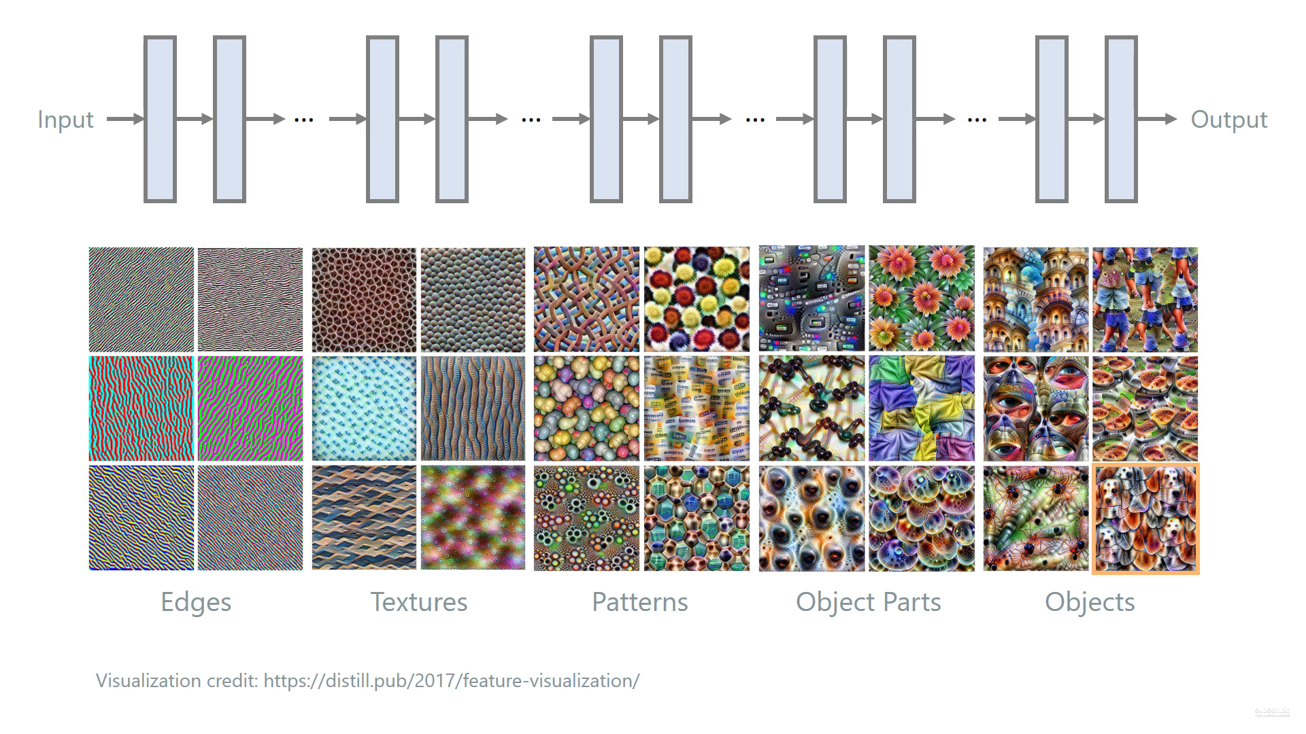
Hierarchical Layers
Notes:
Veel data nodig om hierarchische opbouw te doen van features, daarom gaan we de basic building blocks meestal hergebruiken bij transfer learning

Slide 7
Transfer Learning

Slide 8
Transfer Learning
Deep Learning is data hungry
Deep Learning is compute intensive
→ Can we use previously gathered knowledge?
Standing on the shoulders of giants…
Possible re-use of:
Model architecture, or parts of it
Pre-trained model: re-use first layers? Last layers?

Slide 10
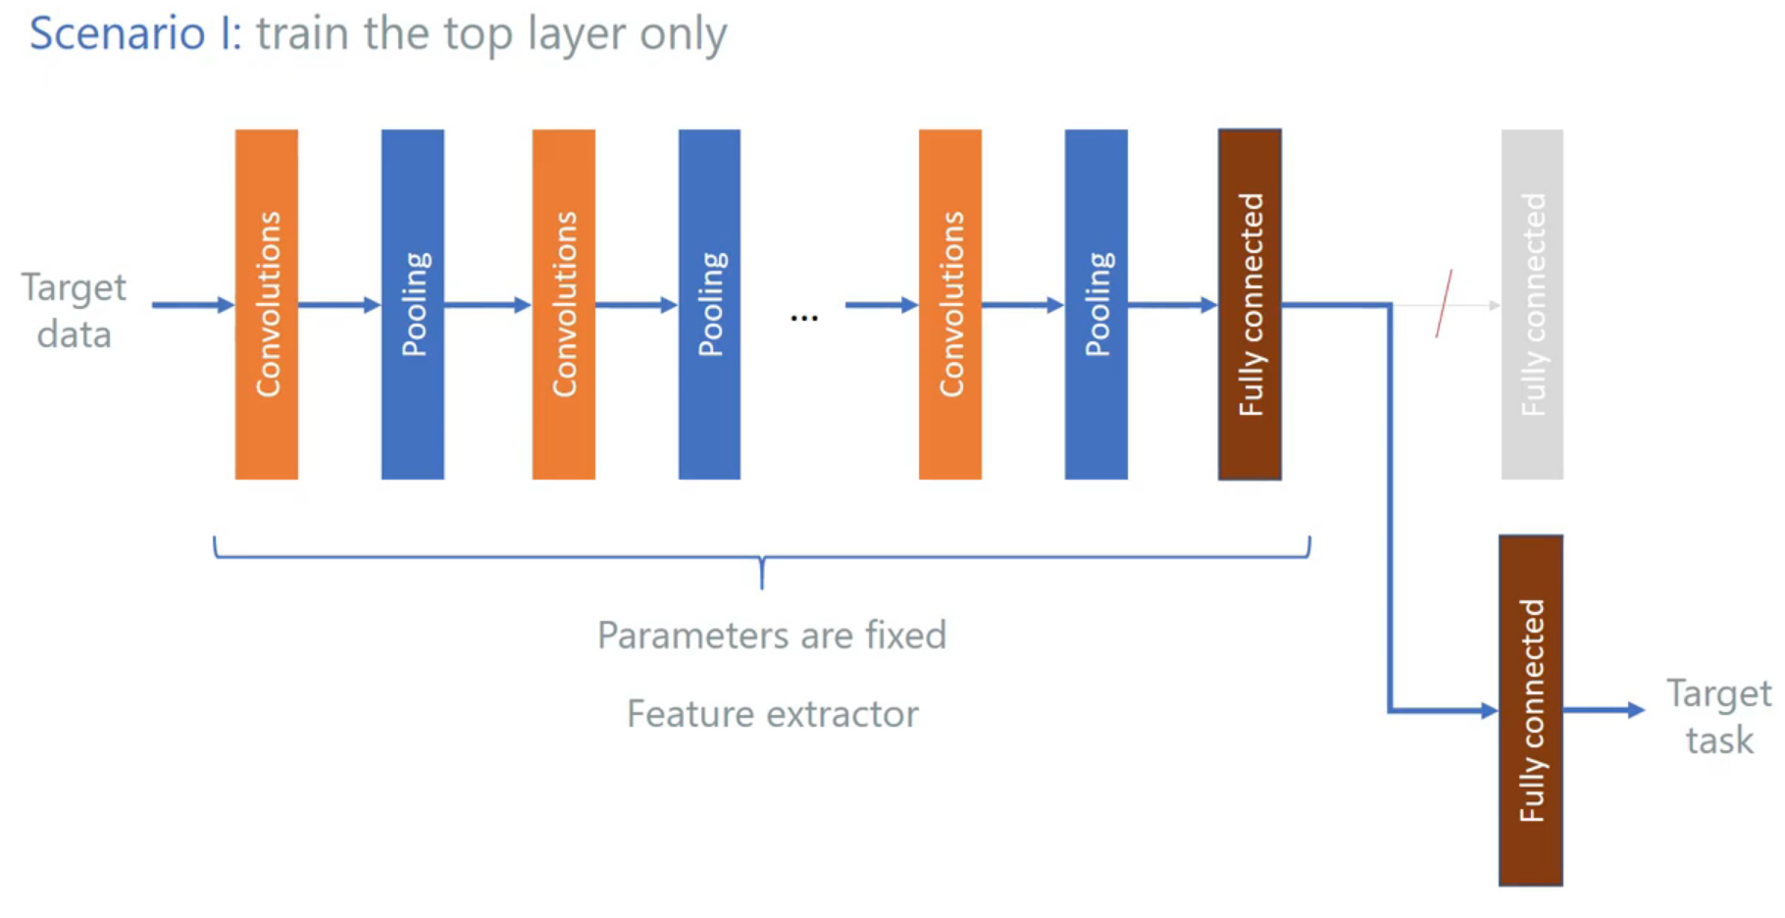

Slide 11
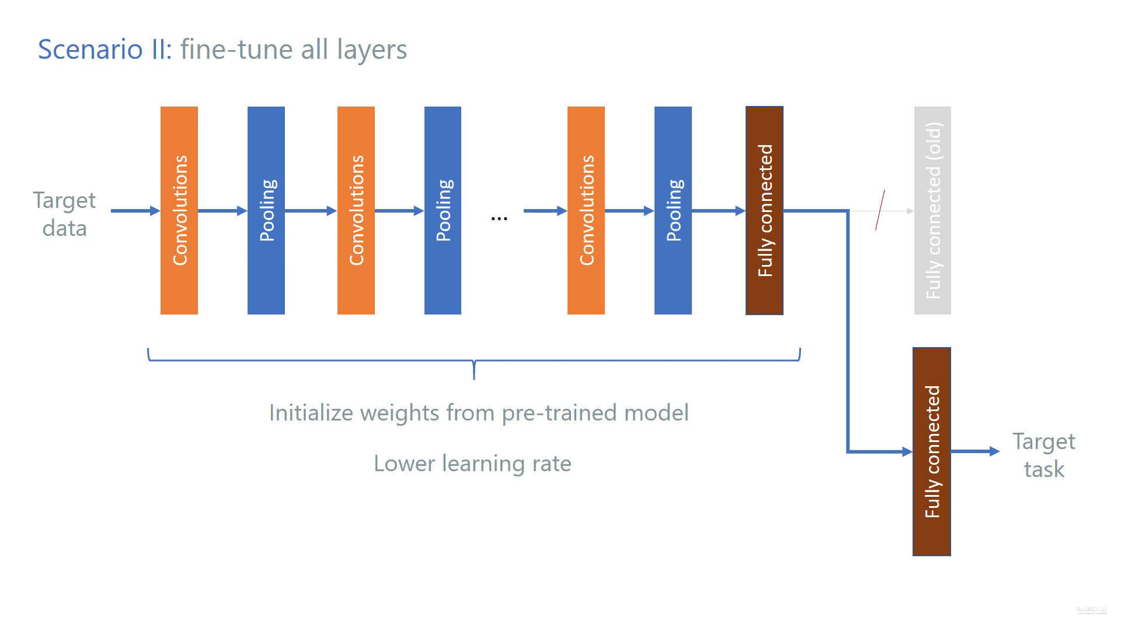
Notes:
Best practise: freeze all layers, behalve de laatste, train. Daarna unfreeze, en tweak de andere lagen een beetje

Slide 13
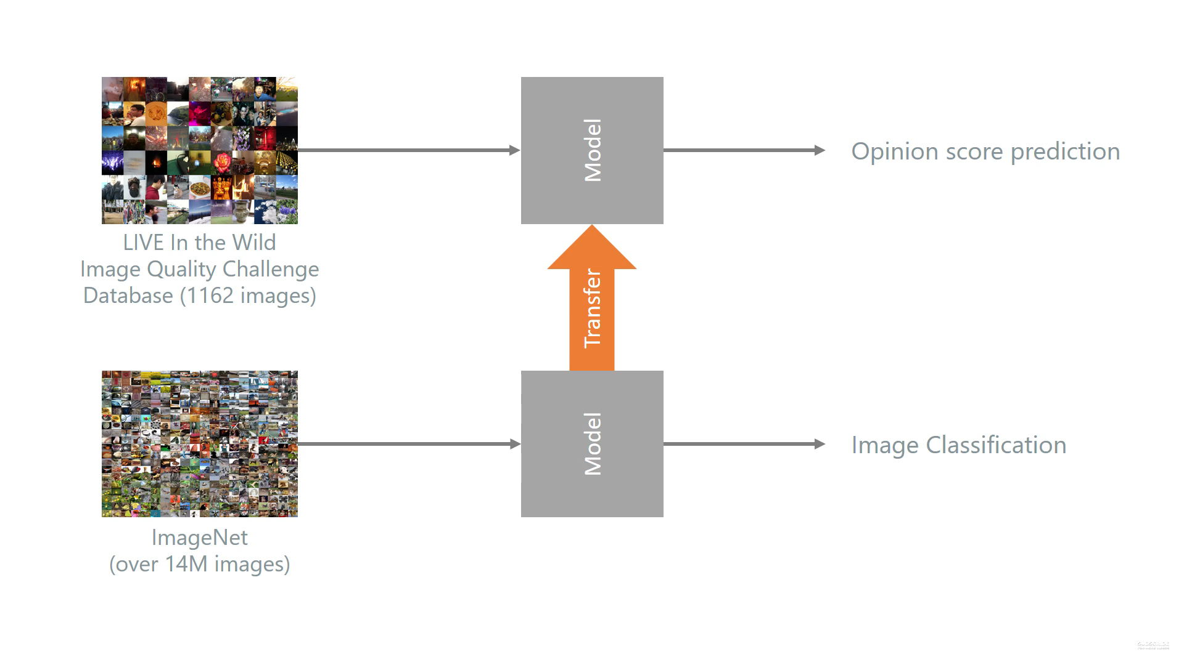

Slide 14
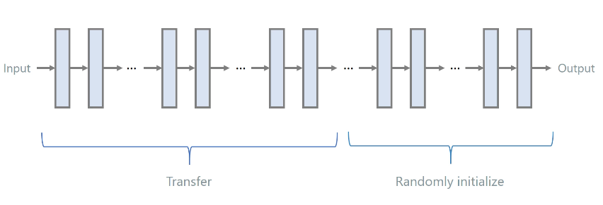
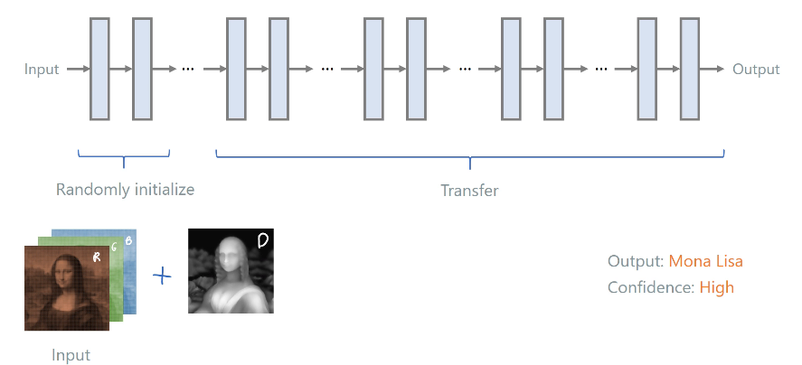
Notes:
Bovenste is meest gebruikte manier van transfer learning, om de main features te hergebruiken
De onderste manier kan soms ook werken, meestal als je zeer gelijkaardige input hebt, die toch net een klein beetje anders is. Die eerste lagen moeten dan immers eerst leren die input wat te projecteren in andere dimensies. Eenmaal in die dimensies is het weer min of meer hetzelfde zoals bij het eerste netwerk, en kunnen we dat deel dus gewoon transfereren.

Slide 15
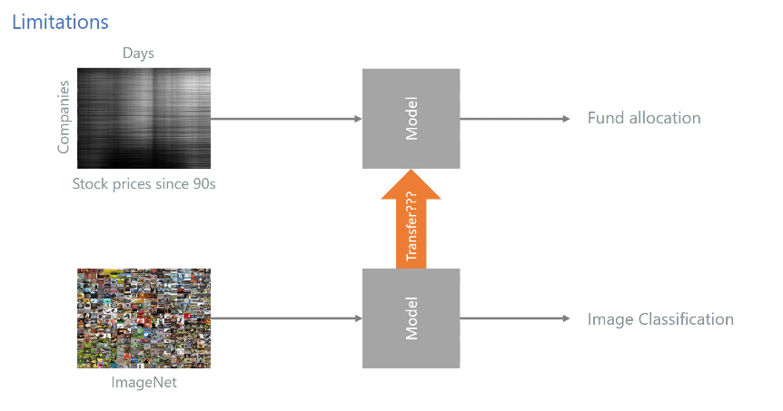

Slide 16
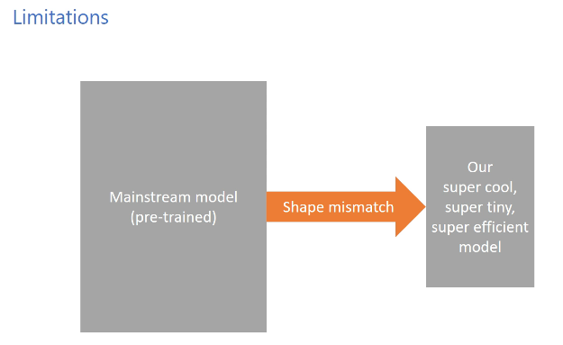
Notes:
Wanneer er een te groot verschil is tussen de architecturen van de 2 models, kunnen we moeilijk de knowledge, de weights, zomaar gaan transfereren

Slide 17
Image Classification Pre-trained models (model zoo)

Slide 18
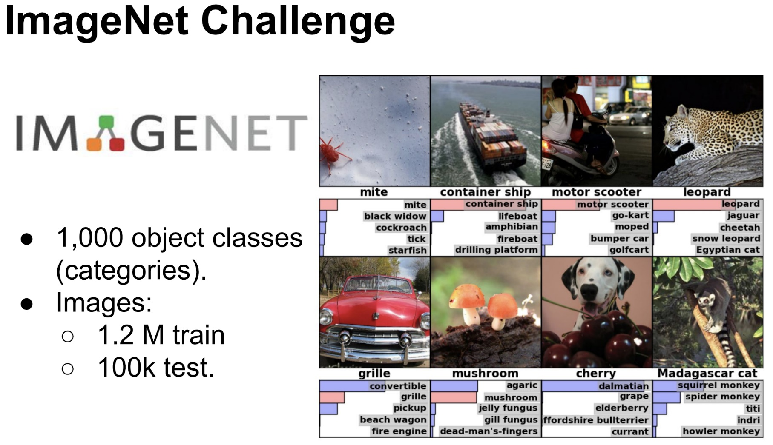
ILSVRC (Imagenet Large Scale Visual Recognition Challenge)

Slide 19
ImageNet

Slide 20
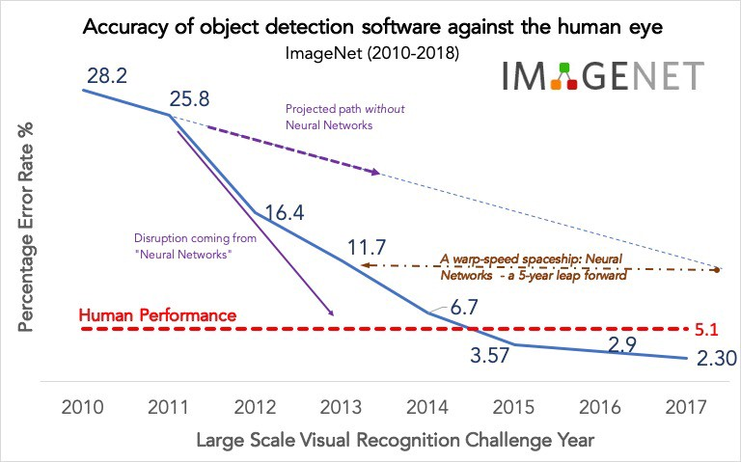

Slide 21
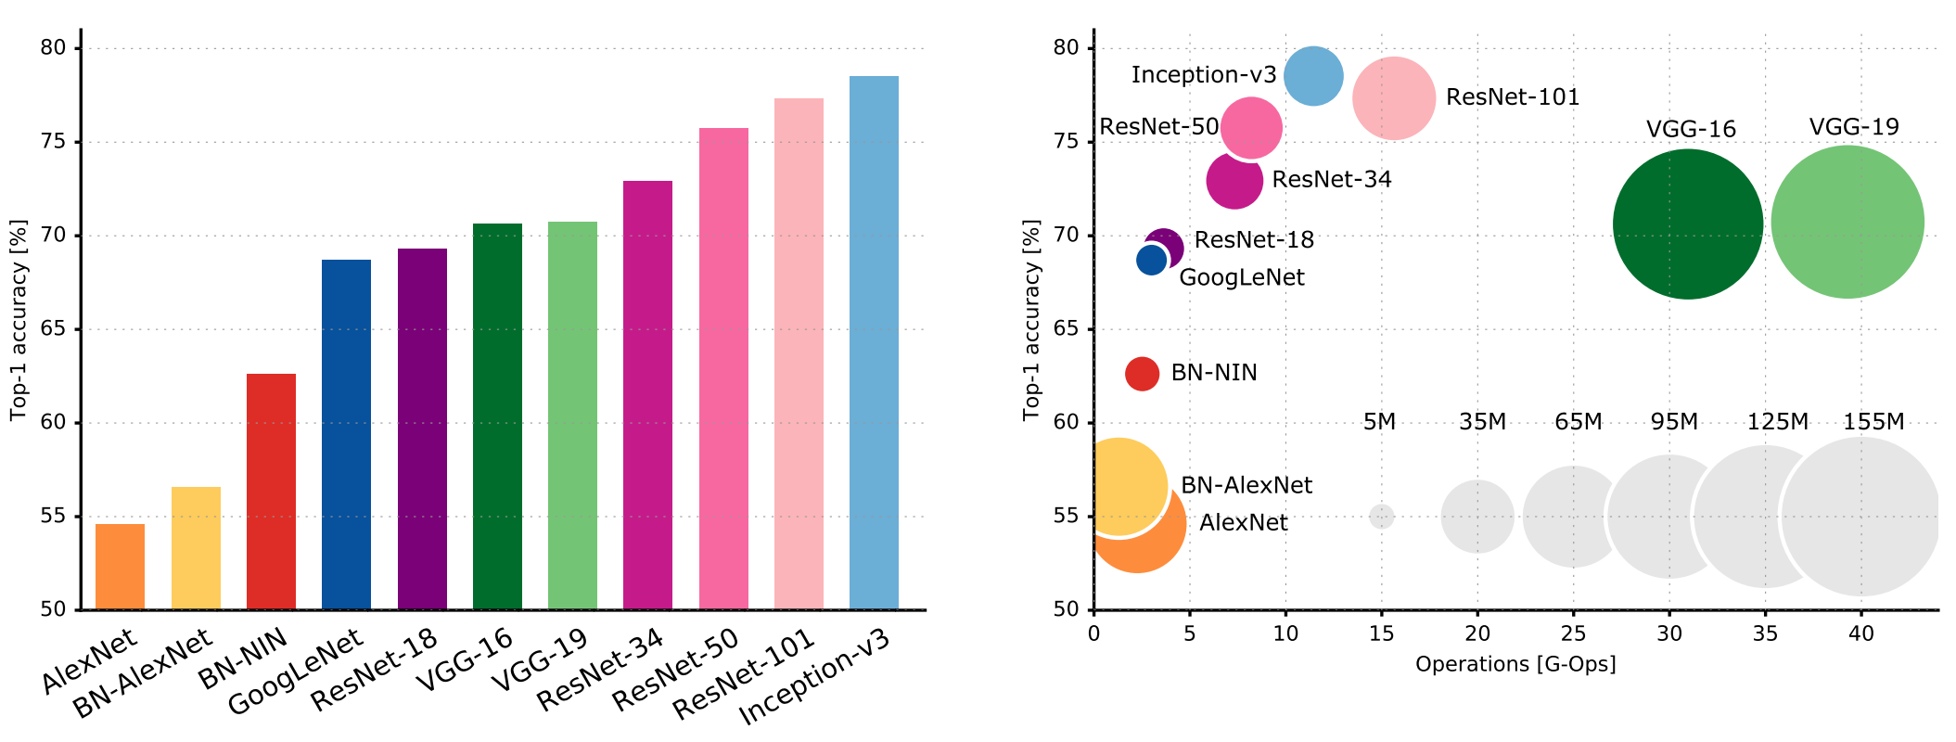
Architectures
Notes:
Dit zijn Top-1 accuracy scores: geef mij enkel welke klasse jij denkt dat het is (uit de 1000). Meestal neemt men de top-5 accuracy score: geef mij je top 5 van mogelijke classes, en dan zien of de correcte erbij zit.

Slide 22
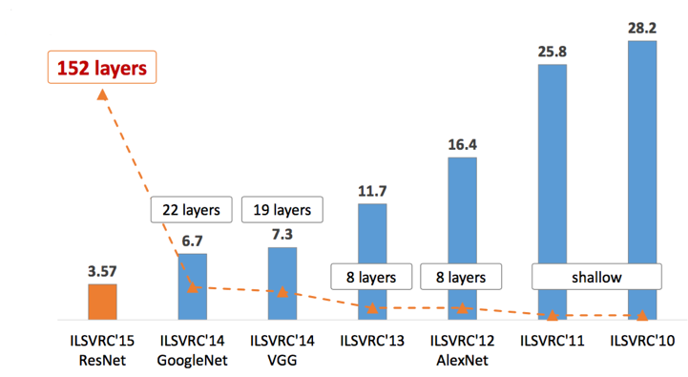
More layers → better

Slide 23
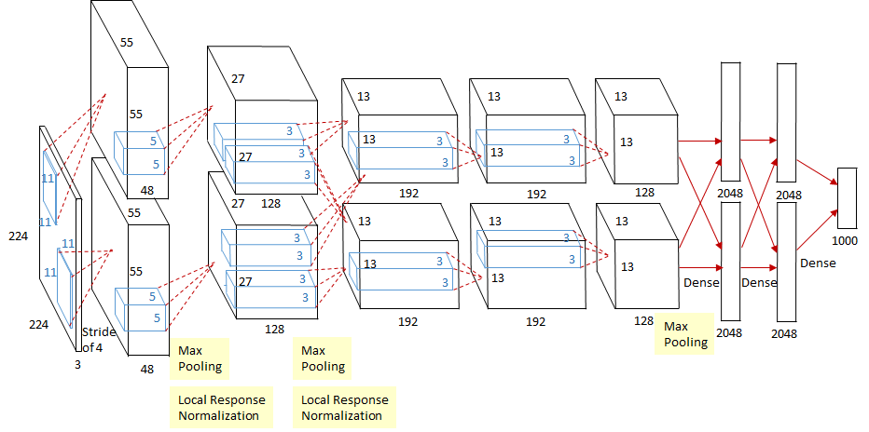
Alexnet
Innovations:
Stacking of conv layers (no pooling in between)
Local Response Normalization
Strongly activated neurons will inhibit nearby neurons to also fire
Result: neurons compete to specialize to different features in the images
Mitigate overfitting:
Very high drop out rate (50%)
Randomly shifting training images by offsets

Slide 24
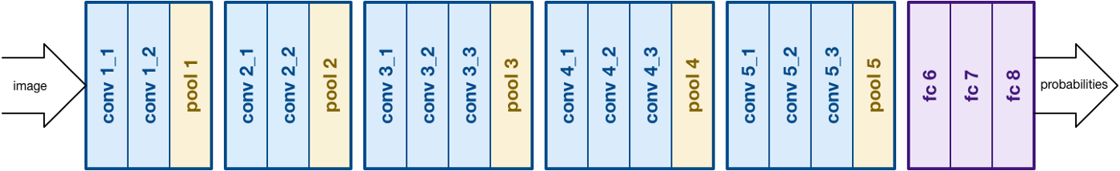
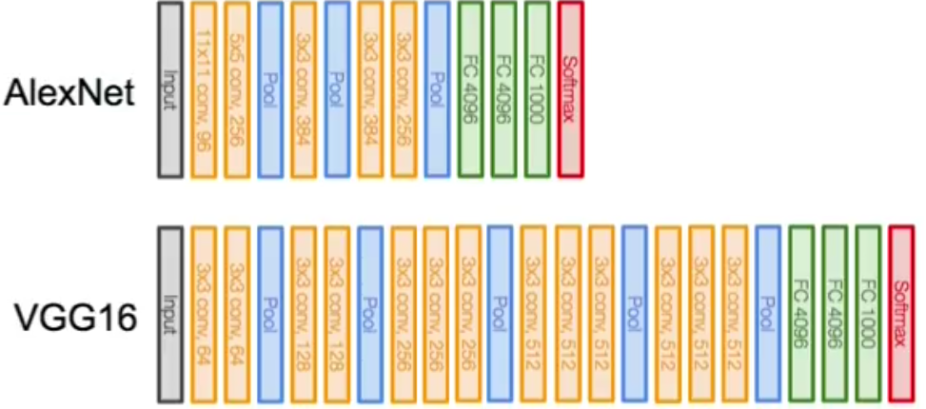
VGG
Innovations:
Stacking multiple small filters, without pooling
Stack 3 conv layers of 3x3 kernel, rather than 1 conv layer with larger kernel of 7x7
Small filters (=kernels)
Exponentially less parameters to train
3 times a 3x3 filter => 3x9=27 parameters, 1 time a 7x7 filter => 1x49=49
(Can be used for dimensionality reduction, extreme case: 1x1 filter – see interim slide)
More representational power, more (localized) feature detectors
Notes:
Oxford VGG

Slide 25
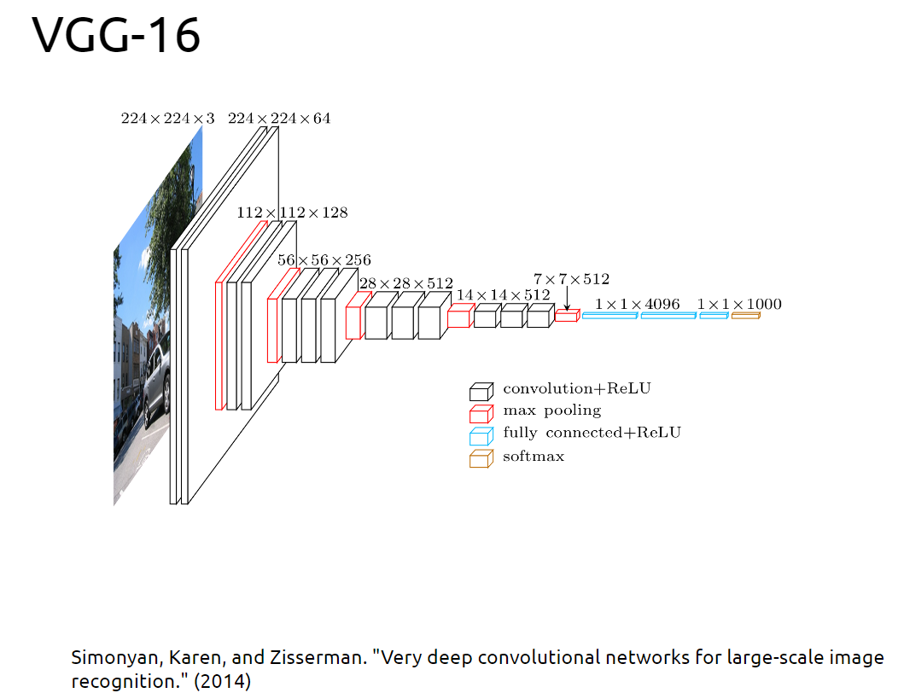

Slide 26
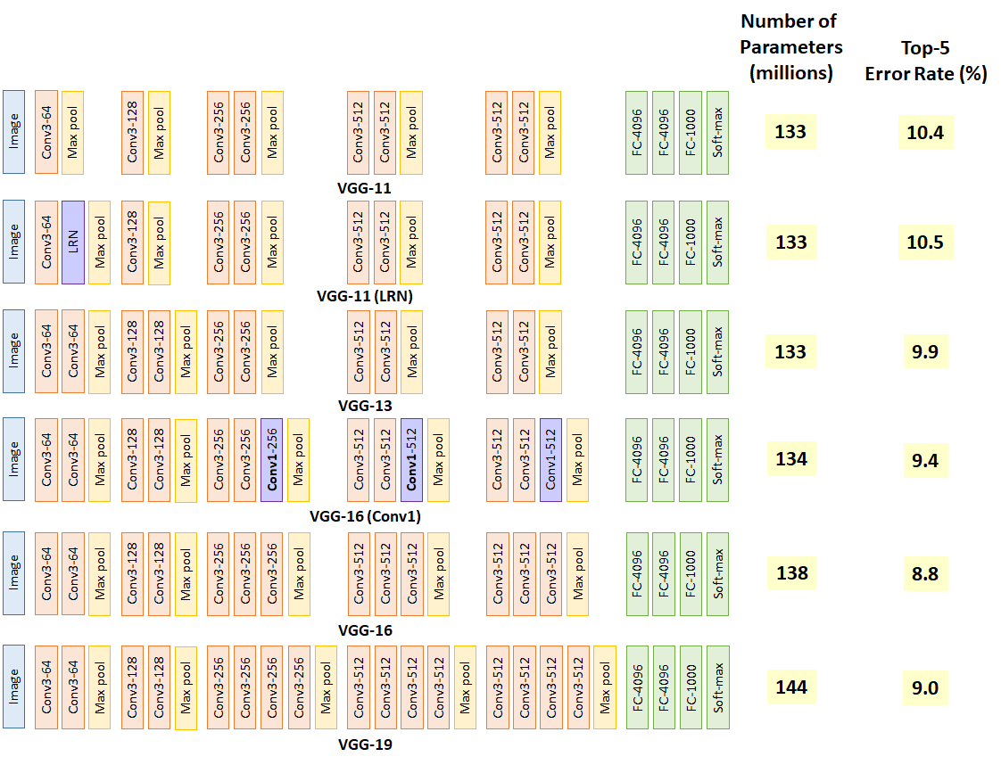

Slide 27
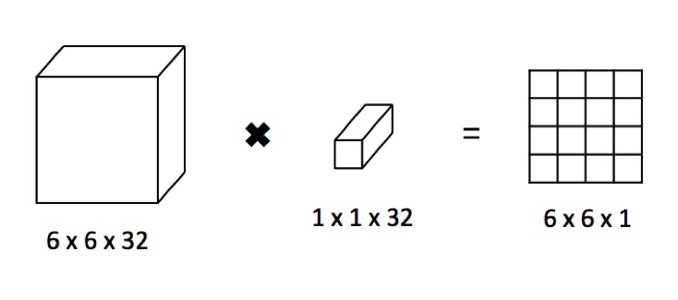
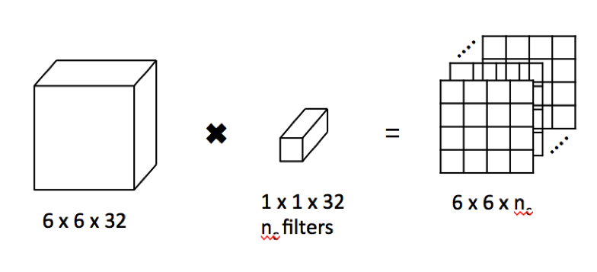
Interim: 1x1 conv (identity conv)
Use: dimensionality reduction (aka less compute)

Slide 28
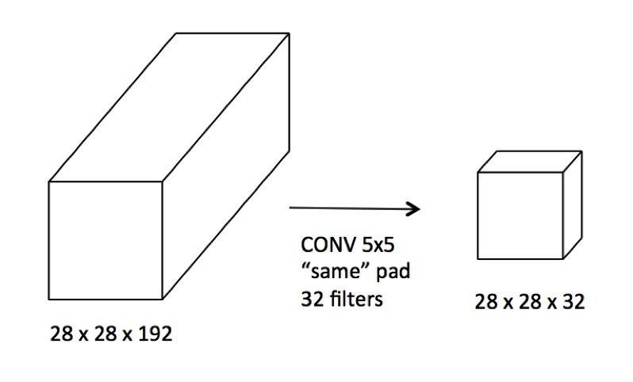
Computational cost:
→ 1 filter (kernel) of 5x5 is 5x5x192 = 4800 for 1 point in the matrix
We have a 28 x28 matrix, so for 1 filter = 4800 x28 x28 = 3.75ml
32 filters gives us: 120ml

Slide 29
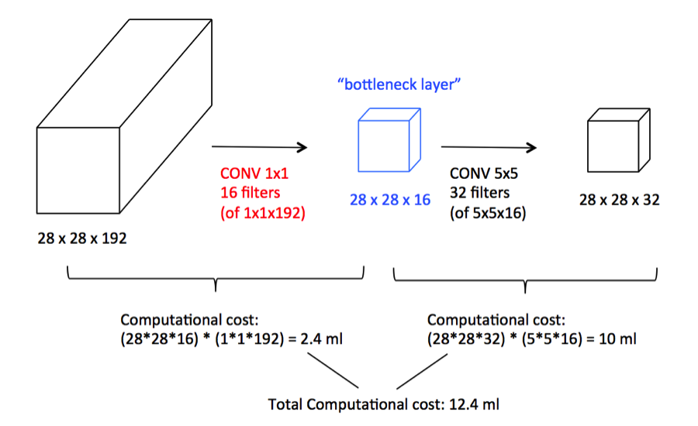

Slide 30
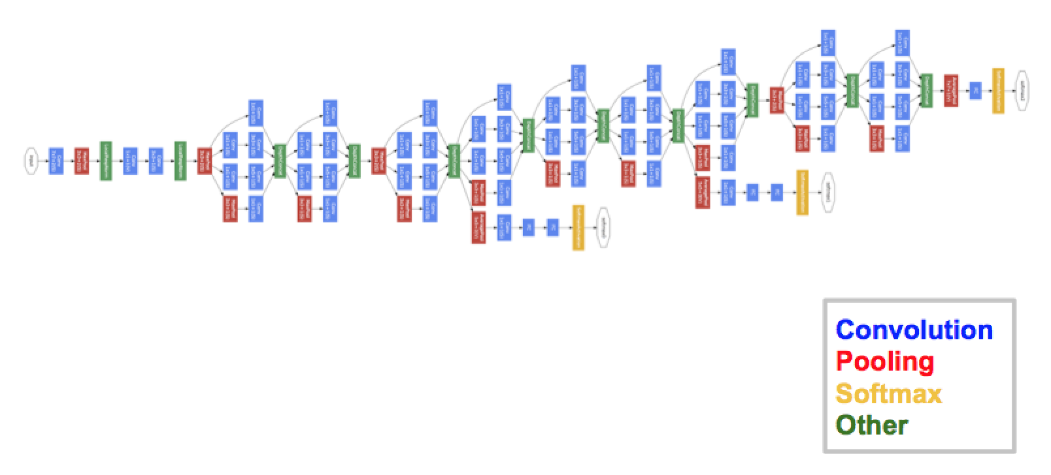

Inception - GoogLeNet
Innovations / insights:
Huge variation in the location of information in images!
Small kernels/filter → detect information that is more ‘local’
Larger kernels/filter → detect information that is more ‘global’
So, take a mix of the two!
Deeper networks tend to overfit → go wider instead of deeper
Naively stacking conv layers = computationally intensive
Notes:
Google Inception

Slide 31
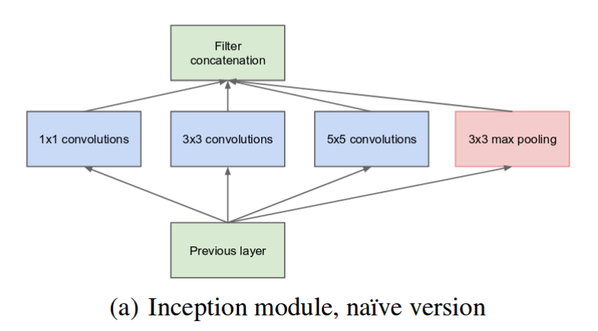
Inception module (naive = comp. intensive)

Slide 32
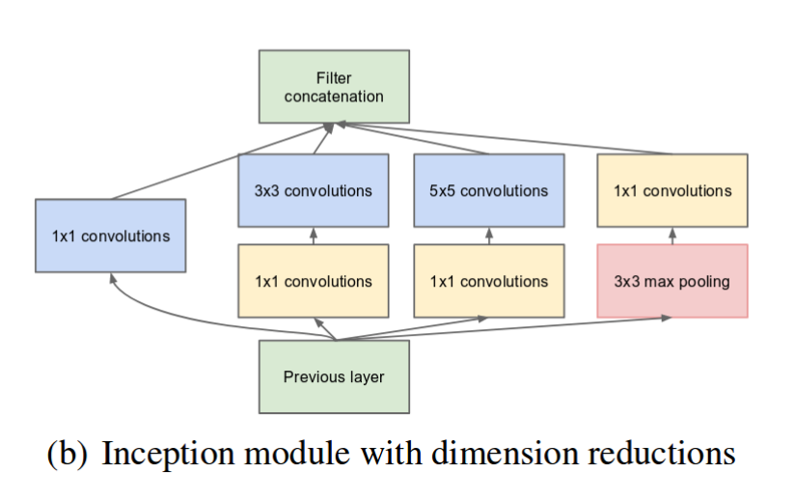
Solution:

Slide 33
Inception - GoogLeNet

Slide 34
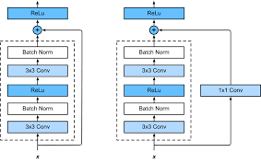
ResNet
Innovations:
Extremely deep architecture (152 layers)
Skip connections (shortcuts)
Residual Learning: forces the model to learn the ‘rest’, what the other layers didn’t
Skip connections makes it easier for gradient to backprop, so we can go deeper
Notes:
Microsoft ResNet

Slide 35
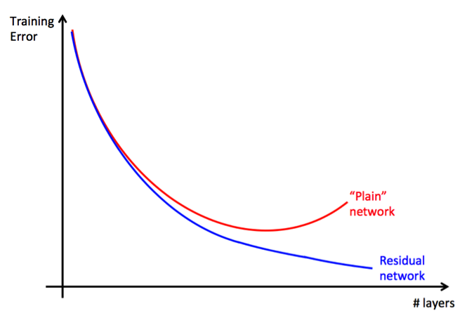
Residual training ➔ easier training for deeper layers

Slide 36
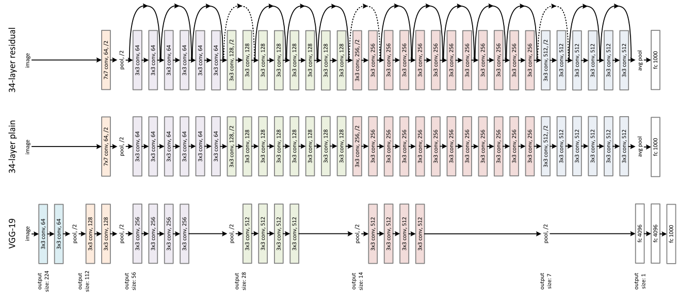

Slide 37
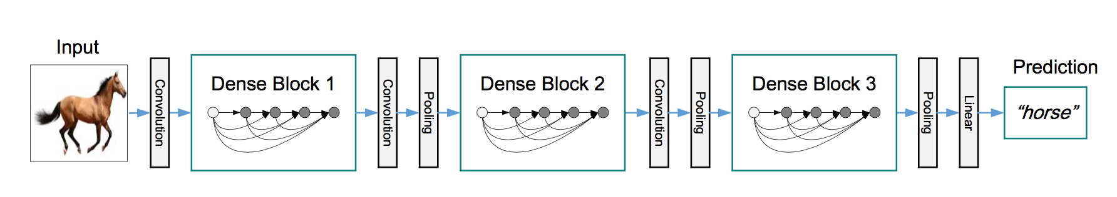
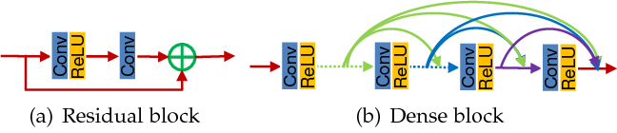
DenseNet

Slide 38
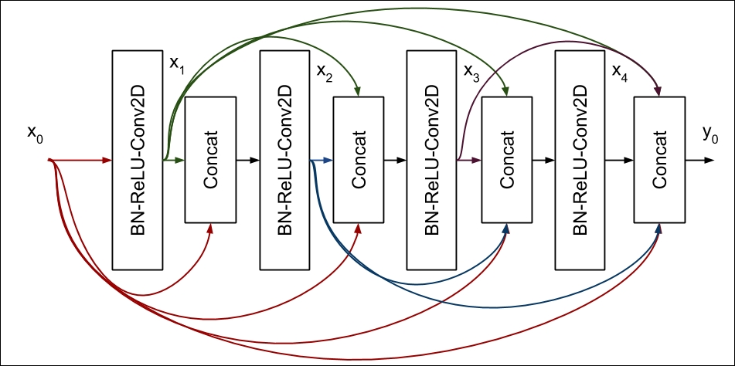
DenseNet
Notes:
Dense block:
Fully connect (‘skip’ connections to every ‘sublayer’ of the block): BatchNorm Layer, ReLU activation, Conv2D

Slide 39
Active Learning (Semi-Supervised Learning)
Notes:
Relatie tot Transfer learning: active learning is een andere approach om toch met minder data een goed deep learning model te maken. Hiervoor moet je wel goede learners gebruiken uit je dataset…

Slide 40
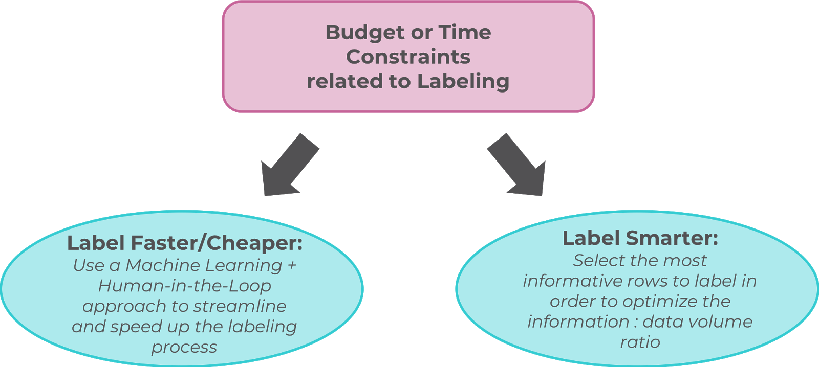
Need for (correctly) Labeled Dataset: ‘Go Fast’, or, ‘Go Smart’? (labeling data at scale challenge)
Notes:
Labeling smarter: big data challenge: how do you label vasts amounts of data? You need to be smart about it. You don’t even need to label everything, just the most important, most informative samples, so you can learn the fastest, with the least amount of data…
Good talk about Active Learning:
https://www.datacouncil.ai/talks/active-learning-why-smart-labeling-is-the-future-of-data-annotation?hsLang=en
https://www.youtube.com/watch?v=riSCBXozTHA

Slide 41
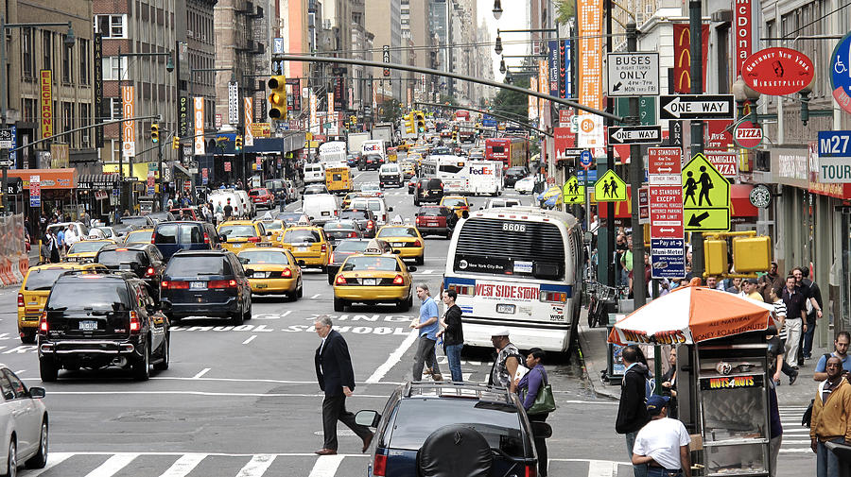
Go Fast problems: Human Labeling? Volume Problem?
~20 cars
x 10 seconds of video
x 30 frames per second
~ 1h40 for labeling of 10s video at 1 box/second
30 frames / second

Slide 42
AI + Human-in-the-Loop Approach
Object detection:
YOLO
SSD
R-CNN
“Fixed” by human annotator
Notes:
Mix between go fast, and human in the mix…

Slide 43
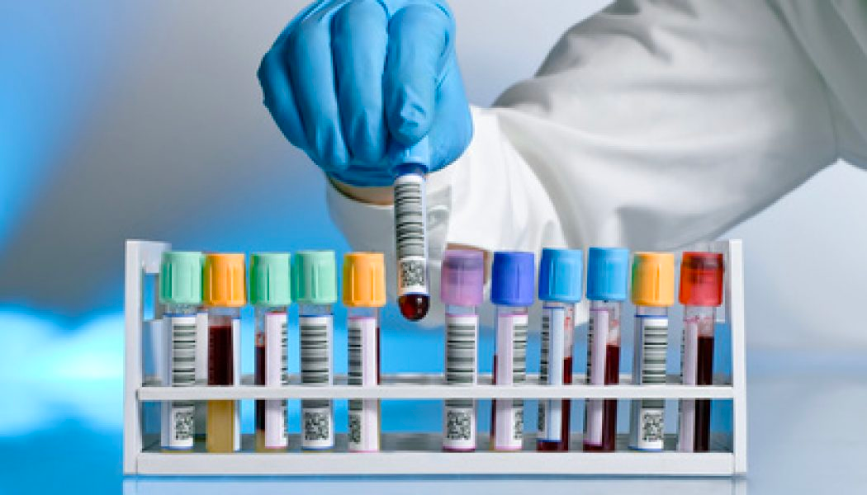
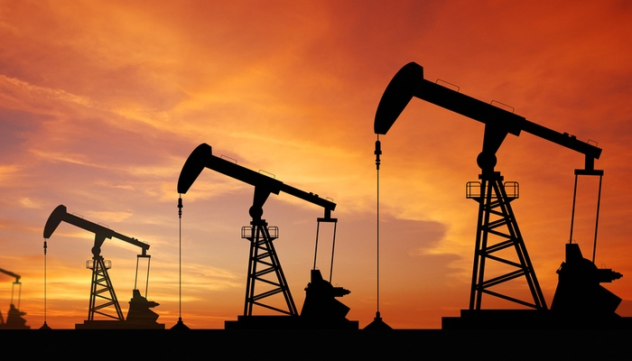

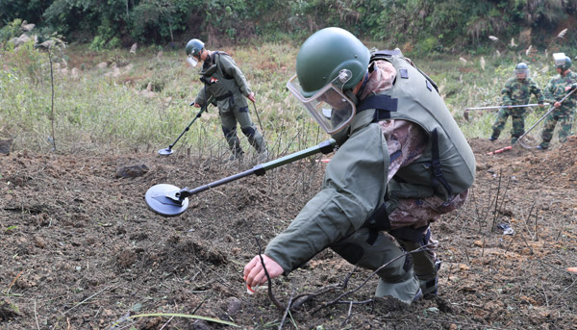
Labeling Data can be…
Even single annotations can be:
Hard to obtain
Expensive
Time-Consuming
Dangerous

Slide 44
Stages of Semi-Supervised Learning
Once & for all
Before Training
During Training
After Training
Entire Dataset Labeling
Active Learning
Manual Override
Prioritizer
Semi-Supervised Learning
Prioritize: before training, hand pick good learners (preliminary assumptions)
Active Learning: choose which data you want to label next (quering strategy), while training your model (select data that is usefull to your model, pick the data that is specifically designed to fit your model)
Manual Override: ‘human-in-the-loop’ approach, when confidence is too low, manually check, and override the label

Slide 45
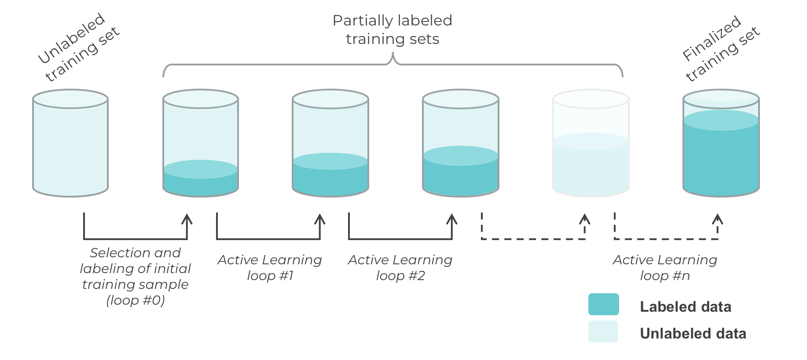
Active Learning cycles

Slide 46

Go Smart… Learn From the Best…
Notes:
Learn from the best, most informative samples first…

Slide 47
Active Learning: example
Unlabeled data

Slide 48

Active Learning: example
Human “oracle”
Initial sample
Notes:
Human oracle selects most promising initial samples to learn from. Human oracle can be domain expert, but you can also use metrics to choose most promising, most informative, samples (entropy, distance from mean image, mean clustering techniques,… or just at random – but less ‘smart’)
Hyper-parameter: how many samples to pull?

Slide 49



Active Learning: example
Initial sample, labeled
Notes:
Human oracle will label those most promising samples

Slide 50

Active Learning: example
Model training
Learning agent
Notes:
Train your model on those samples

Slide 51
Active Learning: example
60% accuracy
Notes:
You will get a reasonably high accuracy, if you chose most promising, informative, samples

Slide 52



Active Learning: example
Inferred labels on remaining data
60% accuracy
Notes:
Now, use your model to infer labels on the ‘unlabeled dataset’. Now you will have other metrics to choose your next-round most-informative samples, like ‘meta data’: for instance the confidence your model gave you during inference, margins between your top-5 predictions, entropy calculations,…

Slide 53
Active Learning: example
Sample selected using querying strategy
60% accuracy
Notes:
Select next round of most promising new samples from your ‘meta-data’ collected during inference.
This part, the querying strategy is most difficult part of active learning…
Usually, confidence levels are used to determine which ones are chosen. Too high is not chosen, because model already knows these. Too low confidence is also probably not a very good choice, because these might be ‘spam’, or ‘bad’ samples, samples with little to no good information to use,…or…they might just be the ones your model is really bad at classifying…so they might actually sometimes be (really) usefull…

Slide 54



Active Learning: example
60% accuracy
Notes:
Correctly label those next round most promising samples

Slide 55
Active Learning: example
Model training
60% accuracy
Notes:
Train some more with those new examples to get higher accuracy model

Slide 56
Active Learning: example
90% accuracy
Notes:
Repeat proces of inferencing (now with higher accuracy model), select most promising samples,… → until you run out of time / money / samples

Slide 57


Slide 58


Slide 59
Model Distillation – special case of ‘transfer-active learning’
Notes:
More like ‘mimic’ learning

Slide 60



Notes:
Model distillation:
Stel dat we veel data hebben, maar we hebben niet de resources om zo veel te trainen, of deep model in memory te laden. We zouden dan de outputs, en dus niet de weights, van een pre-trained model kunnen gebruiken, om ons netwerk te trainen. Dus eigenlijk trainen we ons nieuw netwerk om het grote teacher netwerk te ‘mimic’-en

Slide 61
Object Detection & Segmentation (next week)

Slide 62


Slide 63
Object Detection and Segmentation
YOLO
SSD (single shot detector)
U-NET

